Slide 1



Grant Utilisation Report – February 2022

Slide 2
Background
The Neil Hussey Heart Charity offers free ECGs to young people in Jersey. This offering is currently channelled through secondary schools. Short term plans include to extend it to sport clubs.
For the 2021-2022 academic year, the Charity projected to deliver 40 ECGs per secondary school and Highlands College, totalling 400 ECGs.

Slide 3
How the grant has been utilised
The Charity relies on an amazing team of volunteering health professionals who will perform the ECG reading. This reading is sent electronically to the UK for interpretation.
The main costs that the Charity incur are:
• ECG Equipment Rental
• Purchase of electrodes
• Interpretation of ECGs by our Medical Diagnostic Imaging Centre in the UK
• Insurance

Slide 4

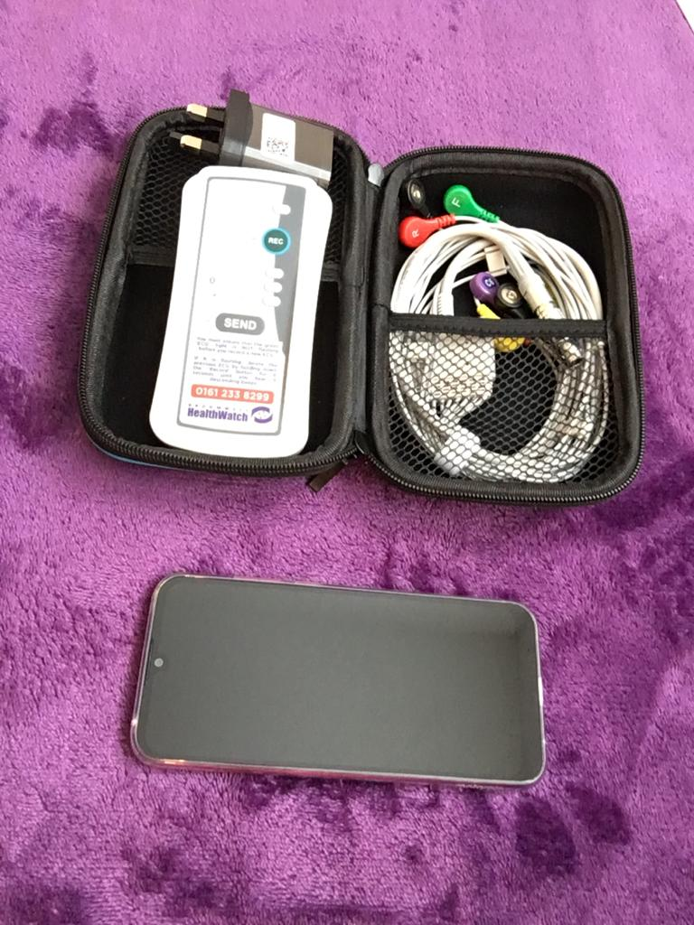
How the grant has been utilised (cont.)
Equipment Rental:
• ECG machine and leads
• Paired phone that captures ECG reading and sends it to the Interpretation Provider

Slide 5

How the grant has been utilised (cont.)
Electrodes:
They have a limited lifespan and are ordered shortly before each ECG event.

Slide 6
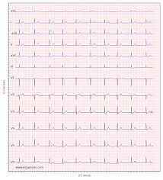
How the grant has been utilised (cont.)
ECG Interpretation:
•Beaulieu Convent School
• Victoria College
• Jersey College for Girls (scheduled for 02.03.2022)

Slide 7

How the grant has been utilised (cont.)
Insurance:
• Malpractice Insurance
• Third Party Insurance

Slide 8
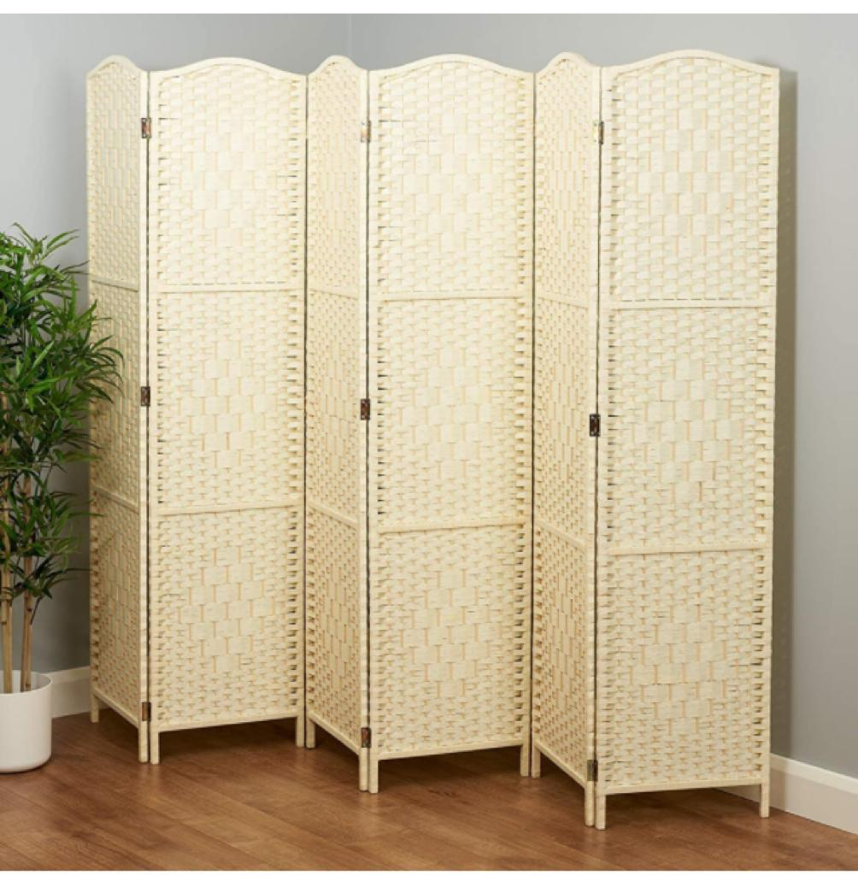
How the grant has been utilised (cont.)
Ad-hoc purchases:
• Room divider to provide privacy and dignity to patients

Slide 9
Summary
Equipment rental ……………………..……………………..£427
Electrodes .……………………..……………………..£76
ECG Interpretation incl March 2022 …………………………. £781
Room Divider .……………………..……………………..£70
Insurance ………………………………………….£1,898
TOTAL ……………………………………………………………………..£3,252

